Slide 1
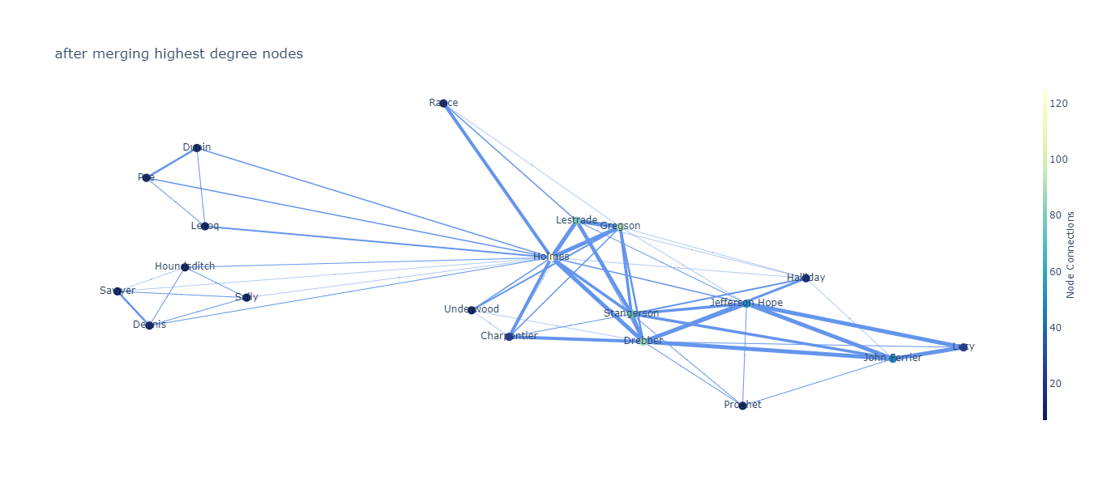
Visualizing Stories
Data Analytics and Visualization Winter 2021
Project Final Presentation
Romina Abadi, Mohammadamin Ghasemzadeh

Slide 2
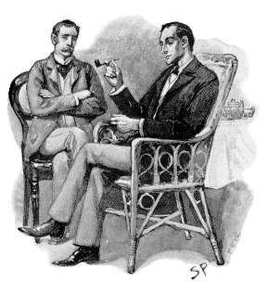
Motivation
Characters and their interactions
“Do authors use similar patterns?”
“Are patterns similar in a genre?”
“What pattern appear in real stories like biography and history books?”
Sherlock Holmes and Dr. John Watson By Sidney Paget
Image is retrieved from Wikipedia.
(https://upload.wikimedia.org/wikipedia/commons/7/73/Paget_holmes.png)

Slide 3
Definition of Problem
Gutendex
Books
Metadata
A subset of Project Gutenberg 3000 books from 142 authors
60 authors with 15+ books
‘Fiction’: ≈1200 books from 90 authors
30 authors with 15+ books
Author
Author’s birth year
Author’s death year
Category
Number of downloads
Several subjects
Correlation, new insights
Notes:
+Romina:
We analysed about 3000 books from 142 authors. 60 of the authors had more than 15 books. Of these 3000 books, around 1200 have ‘Ficition’ in their subjects (we assume they are fictional books), in total 90 authors have fictional books in out dataset, and among them 30 authors have more than 15 ‘fictional’ books. → from these book, we extract characters and their interactions.
+Amin:
in the right side, these are the other data we had from books. Books’ metadata, including subjects; death and birth years of author; and number of downloads from Gutenberg website in the past month, are extracted using Gutendex api. We assume the number of downloads represent the popularity of the books. each book in our dataset has multiple subjects.
using books analyses & metadata, we wanted to find some correlations between parameters and finding new insights about a large group of books.

Slide 4
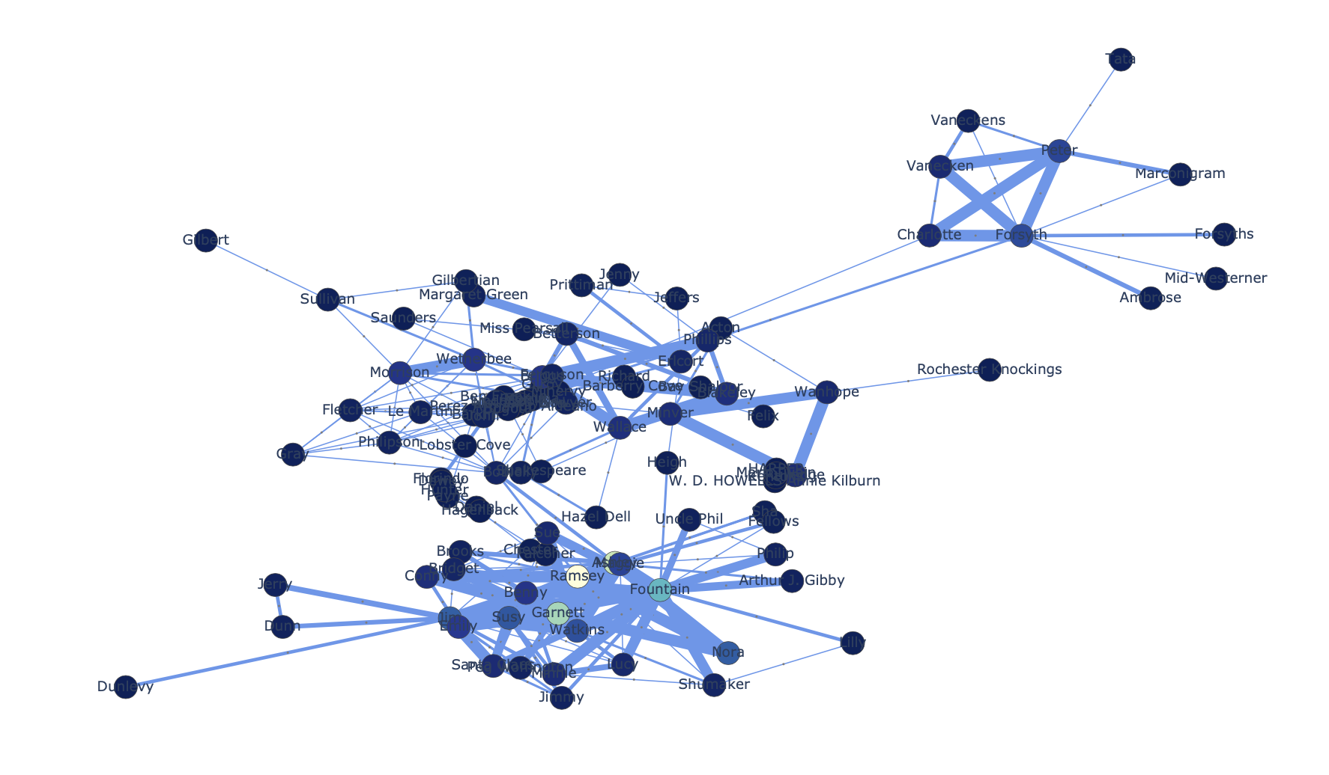
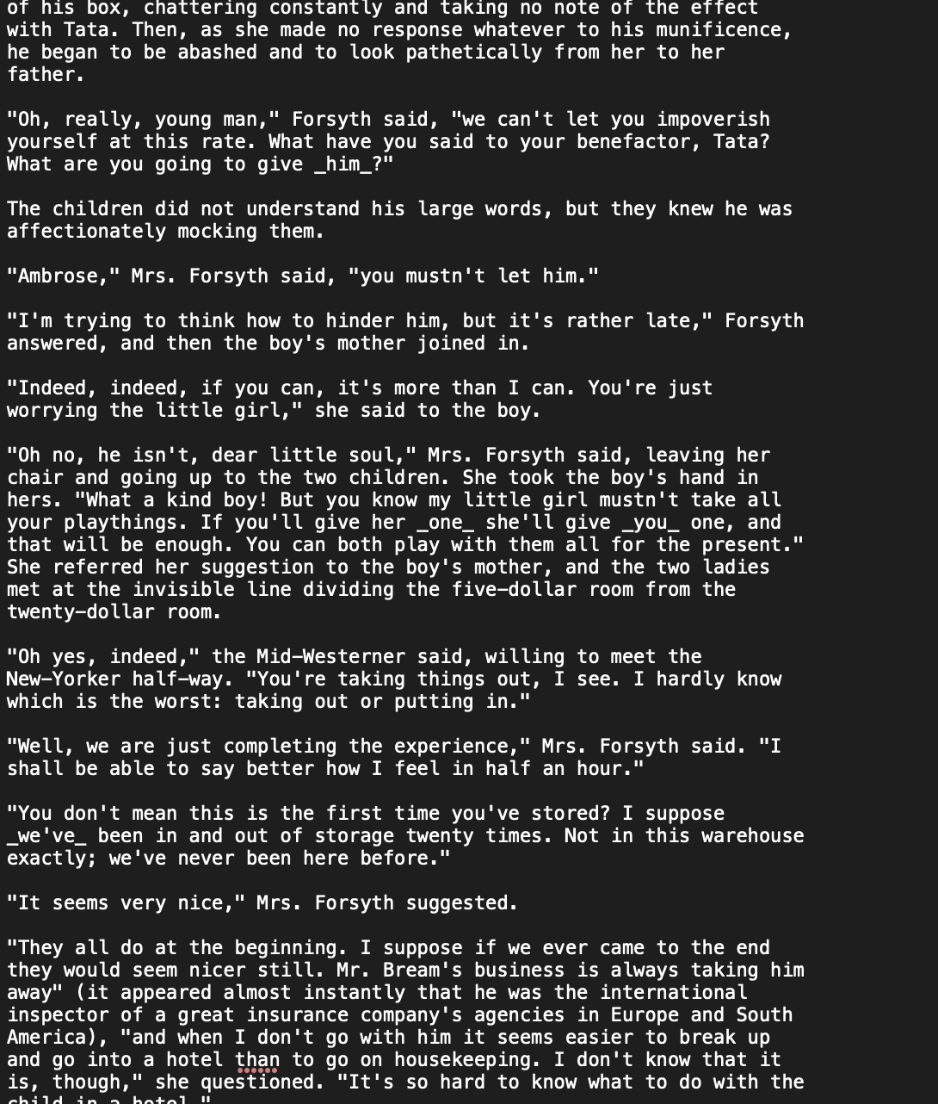
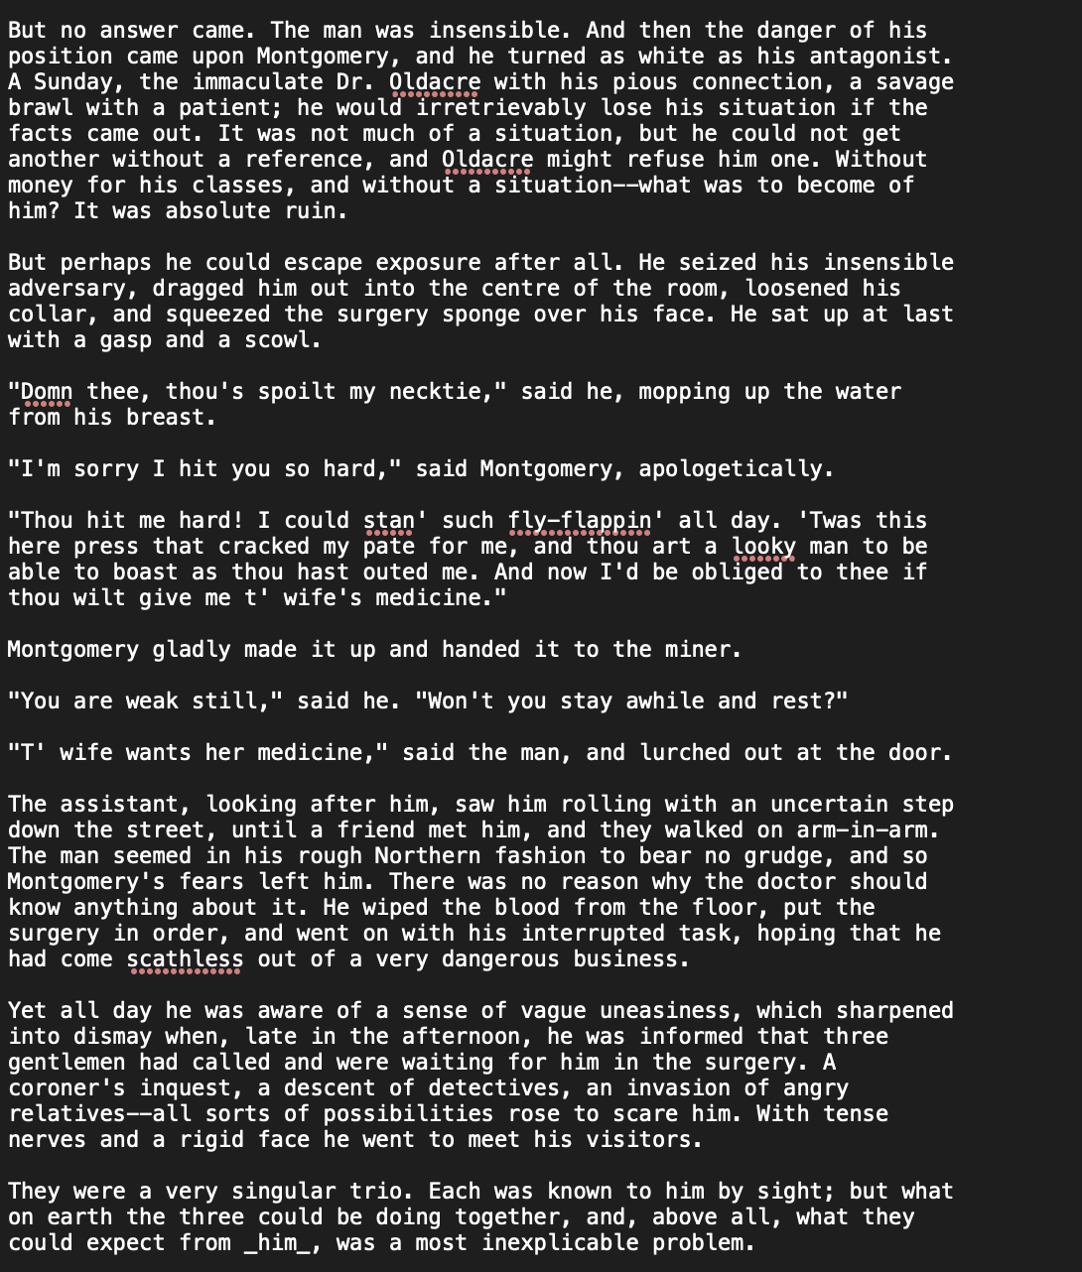
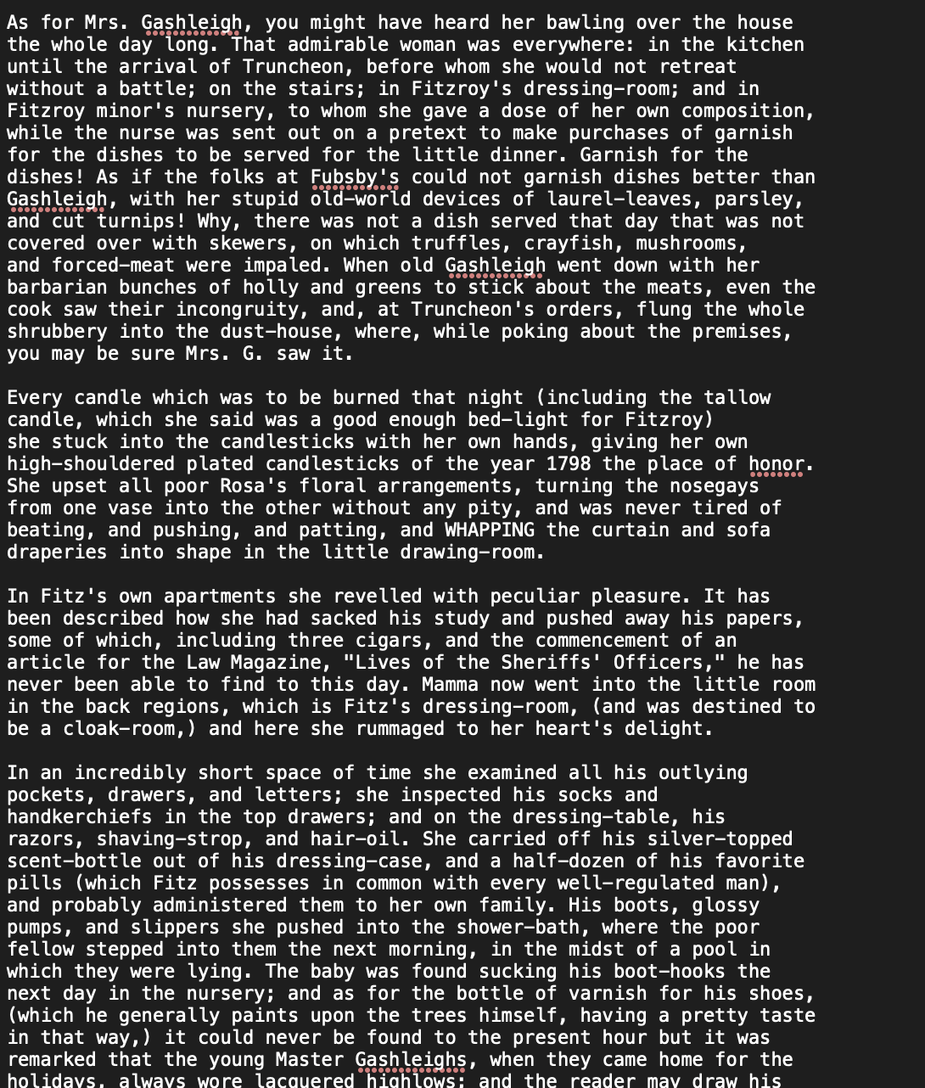
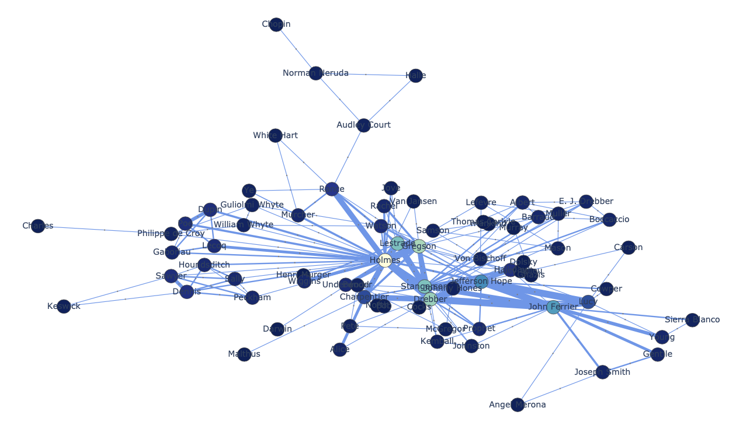
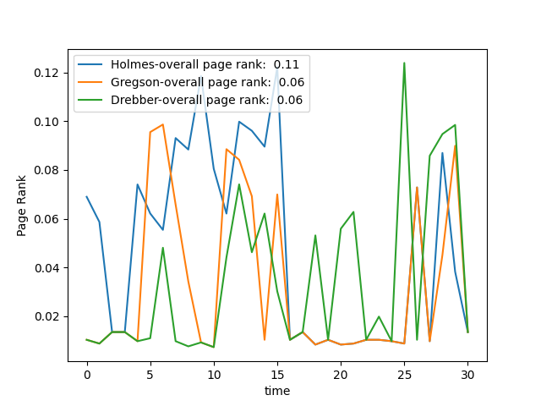
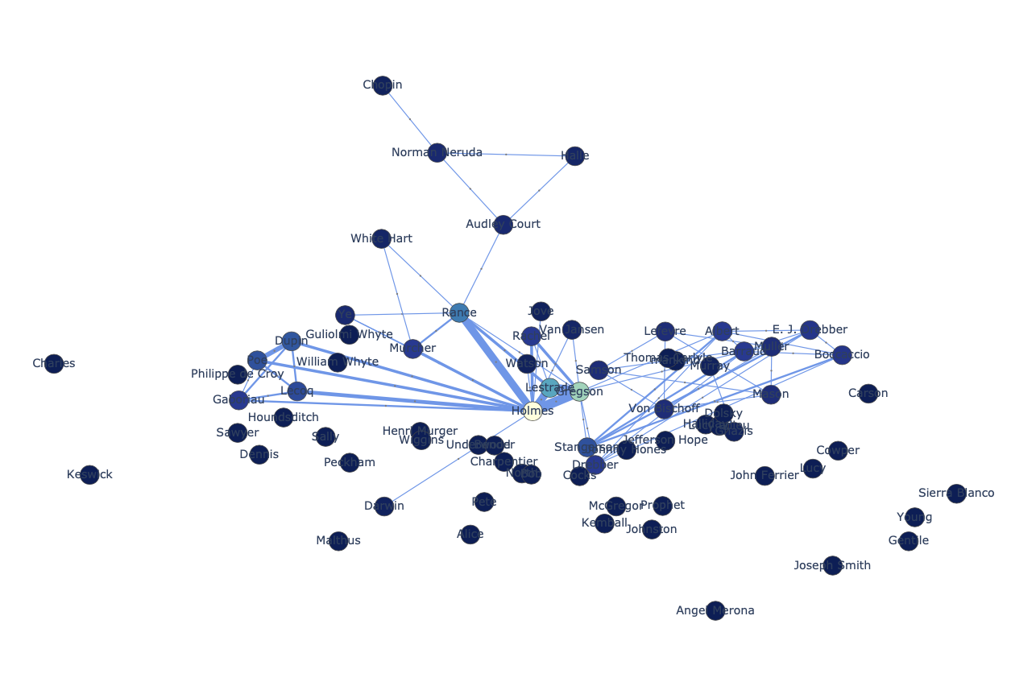
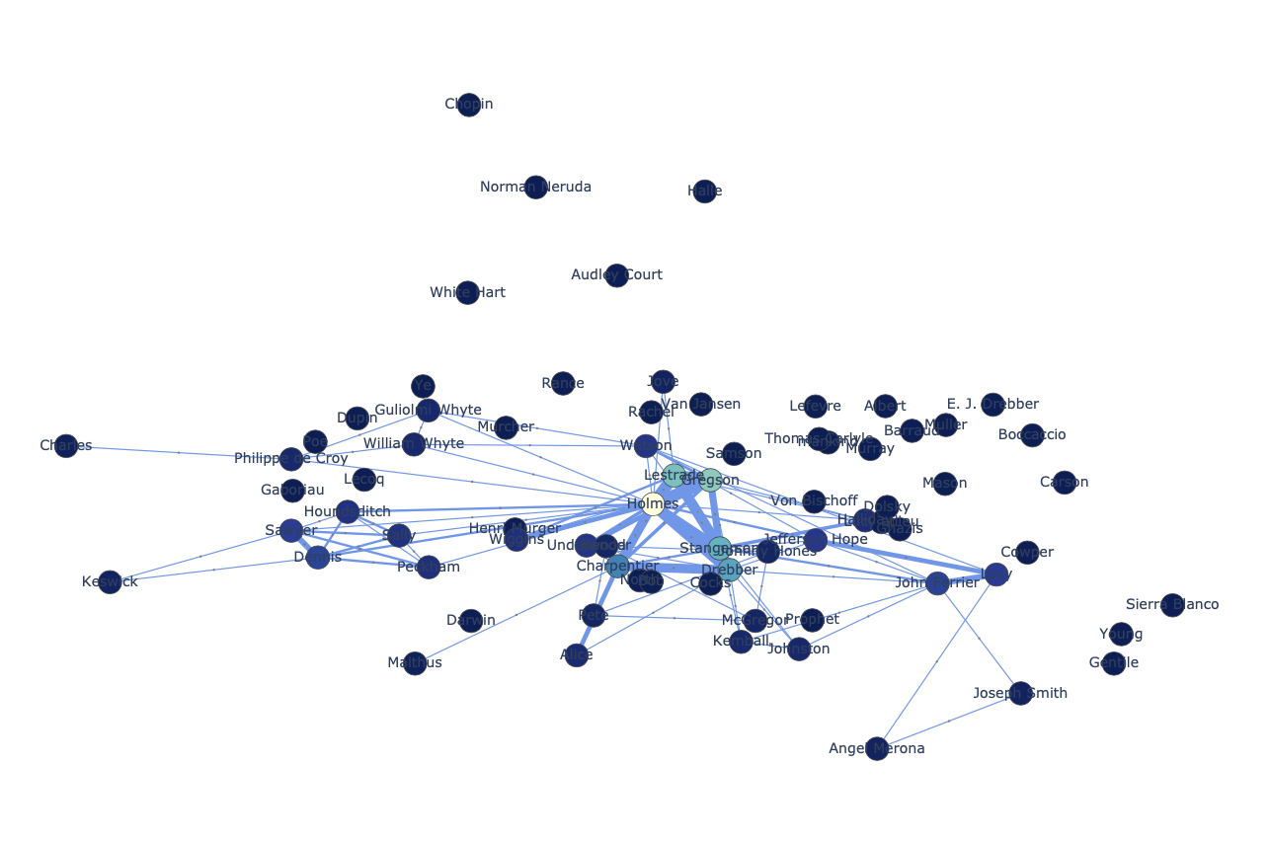
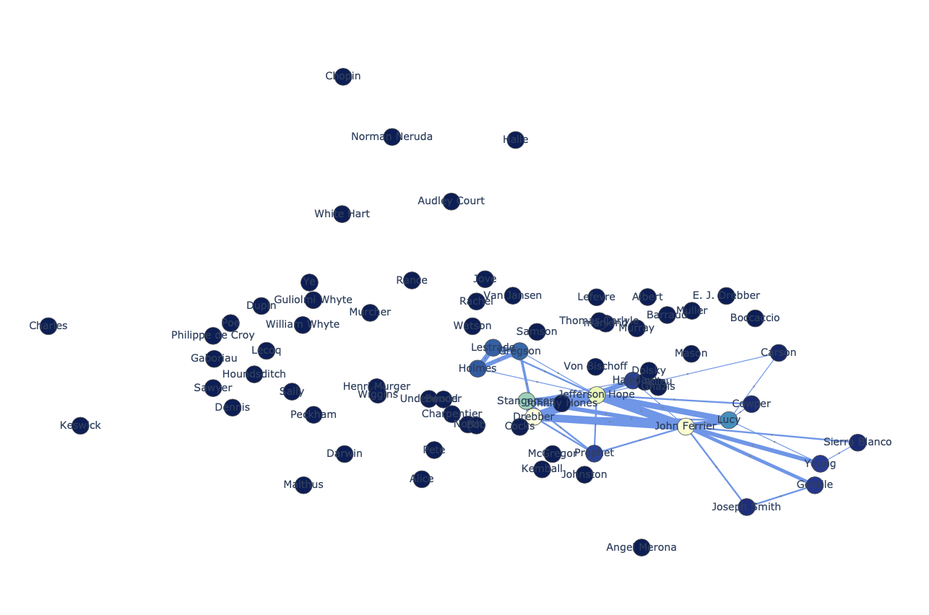
Methods: Character Interaction Network
NER
Characters (nodes)
Co-occurrence
(edges)
#characters (graph size )
#important characters (central graph size)
Importance of the characters (page-rank)
Graph Development Through time
(snapshots)
Notes:
The inputs to the character network extractor are the Gutenberg .txt books.
We read the books and extract the character names using Stanford NER. Then we add edges between the characters that appeared closer than 10 lines together. Two characters can have many interactions. We can many edges between two nodes and we also add a time-stamp to edges to indicate when the interaction happens.The graph size gives us how many characters are in the book and the central graph size gives us how many characters are important in the book, we also analyse the ratio of these two numbers. Also we use page-rank to indicate the importance of characters. Because the edges have time stamp, we can analyse the graph development by analysing snapshots. This gives us information like the change in importance of the characters through time.

Slide 5
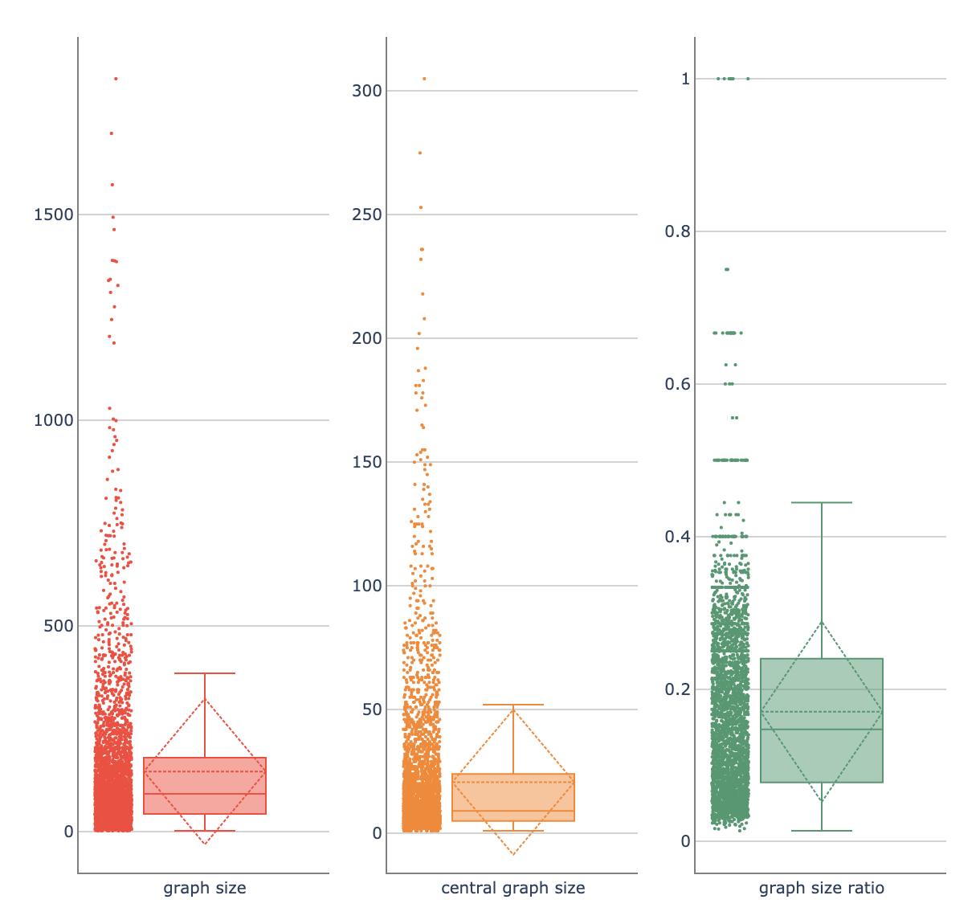
Results: Analysing The Number of Characters
Mean ± Sd and (normalized sd)
Graph size: 145.22 ± 177.47 (1.22)
Central graph size: 20.66 ± 29.32 (1.42)
Ratio: 0.17 ± 0.12 (0.71)
Notes:
These box plots show graph size, central graph size and their ratio for all the books. The dashed lines show mean and variance. The normalized sd in the ratio is smaller than in graph size an central graph size. This suggests that on average the books with large number of characters also have bigger central parts. Also, We can see we have fewer outliers in the ratio plot. These outliers were mostly short stories. We didn’t find a repeated subject in the graph size and central graph size outliers. These plots gave us an overall view of these measure over all the books.

Slide 6
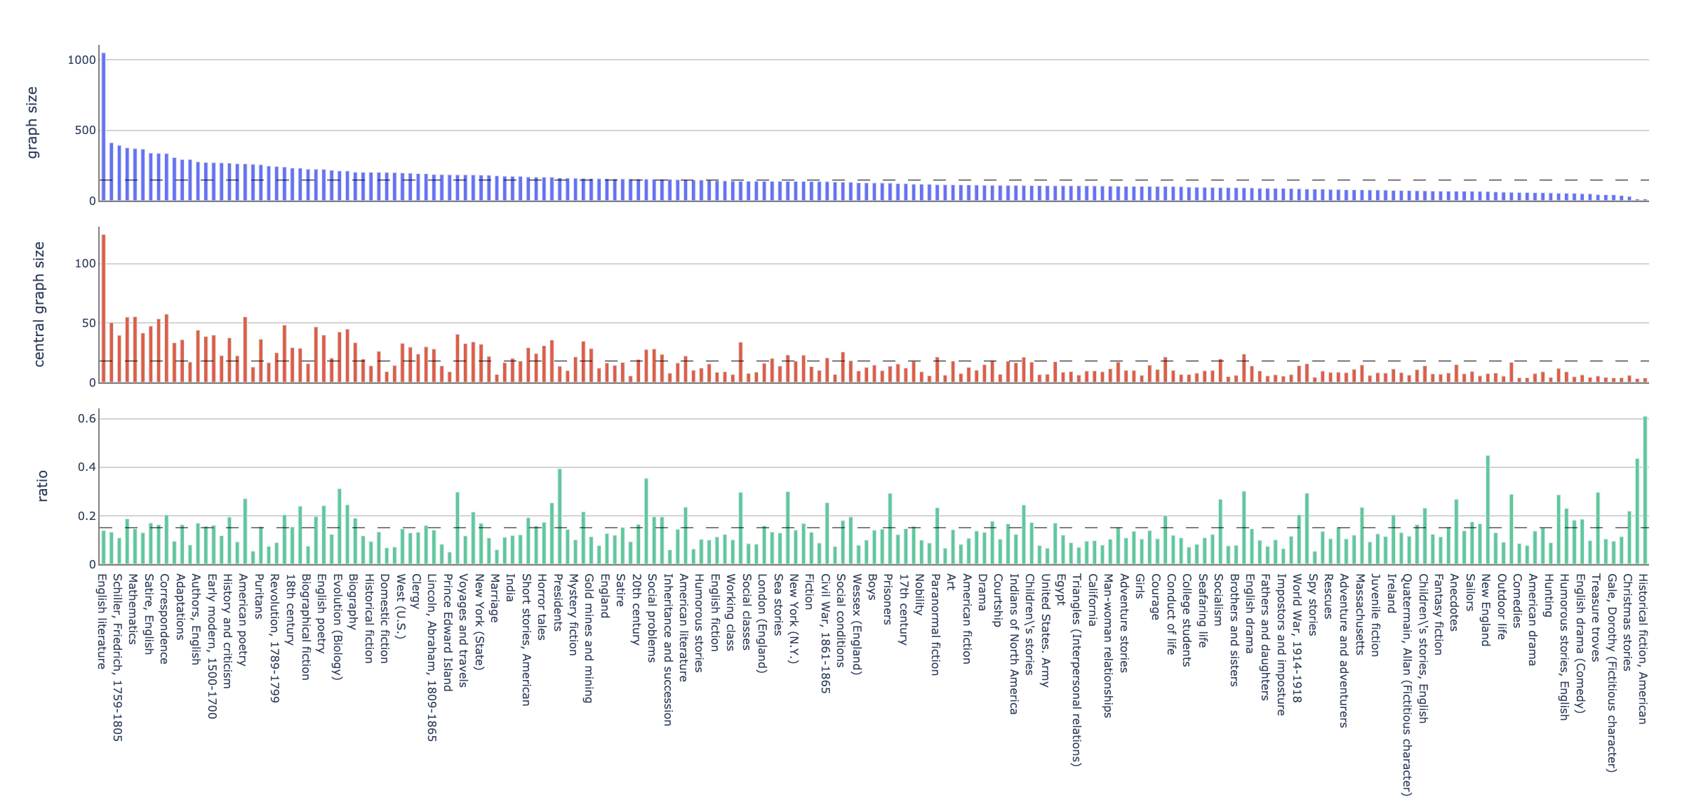
Results: Analysing The Number of Characters for Subjects
Notes:
We plotted the mean of these three measures for all the subjects with more than 10 books. This allows us to compare character interaction network sizes. Let’s take a look at patterns we found

Slide 7
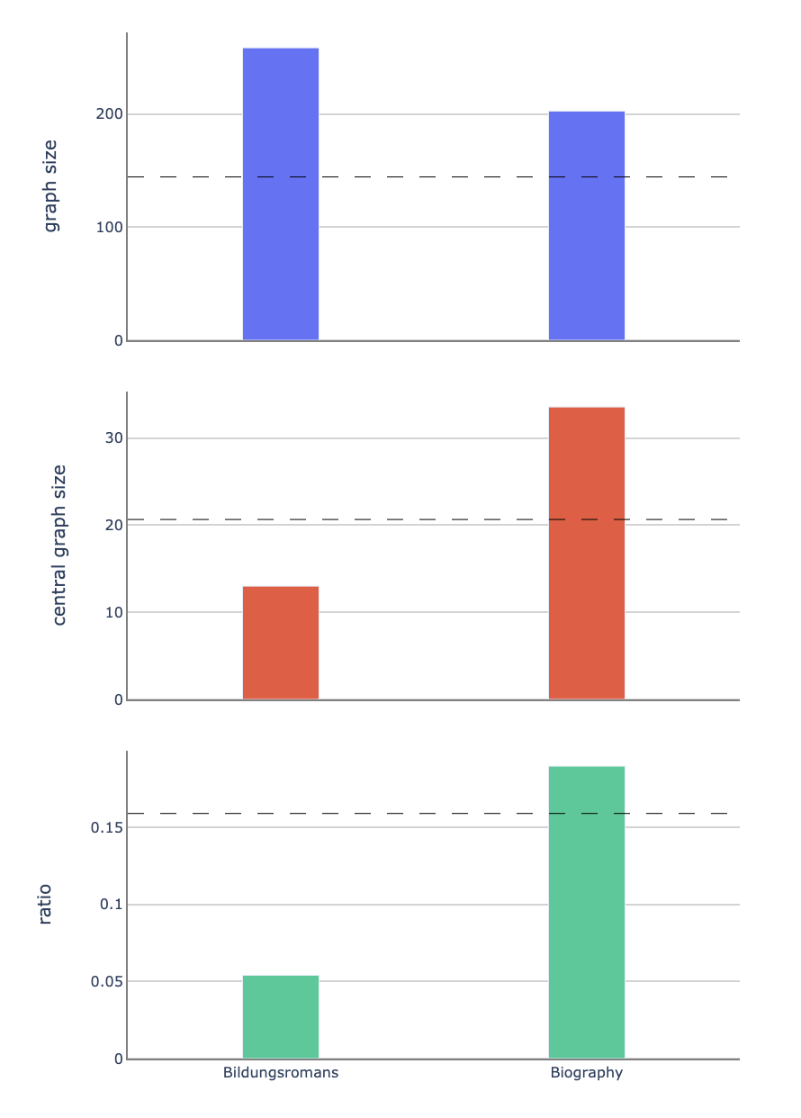
Results: Analysing The Number of Characters for Subjects
Biography (54 books) vs Bildungsromans (22 books)
Bildungsromans examples:
Little Women
The Adventures of Tom Sawyer
Anne Of Green Gables
Oliver Twist
Biography examples:
Alexander the Great
A Daughter of the Middle Border
The Life of William Ewart Gladstone
dashed lines show the overall mean for all books.
Notes:
Here we compared two different subjects which we believed should be similar. Bildungsromans and biographies. Bildungsromans are fictional books that depict one character (or family) throughout time. So we thought the patterns might be similar to real biography books. But in these plots, we see a big difference. We see that in biography books, unlike bildungsromans, it seems that the story is not only focused on the main character. It looks like the story is about many characters. By looking at the books we realized some of our biography books involved a group of people, and we think this difference might be because of that.

Slide 8
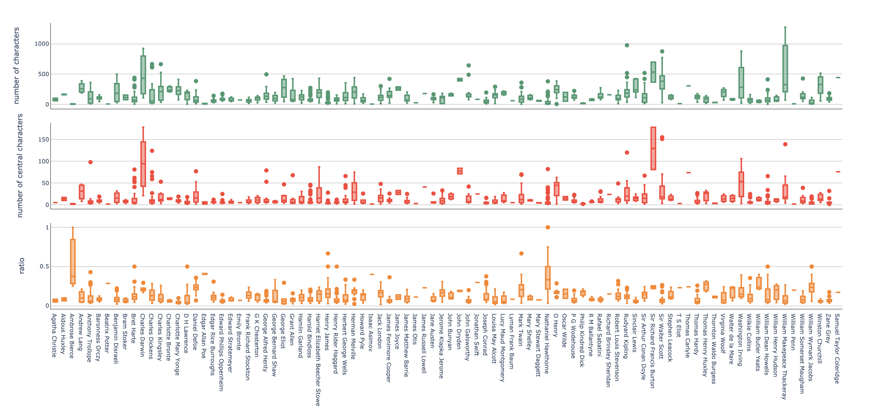
Results: Analysing The Number of Characters for Authors
Notes:
We also plotted box plots of the three measures for different authors. (Maybe remove)
We chose the authors that had many fiction books to compare their writing style

Slide 9
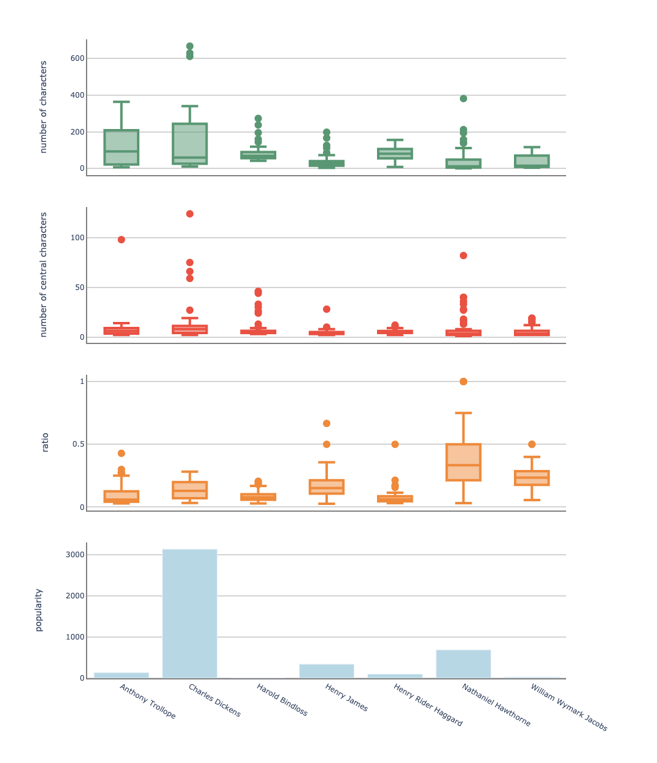
Results: Analysing The Number of Characters for Authors
Authors with more than 40 books (fiction)
Anthony Trollope #books: 64
Nathaniel Hawthorne #books: 57
Henry James #books: 54
Henry Rider Haggard #books: 43
William Wymark Jacobs #books: 43
Charles Dickens #books: 41
Harold Bindloss #books: 41
Notes:
Here is what we found. First of all, we can see that some authors use various number of characters (like charles dickens and Anthony Trollope) on the other hand, for example In Henry James and Harold Bindloss books, the size of the graph is not very different, so their books are similar in that terms. Now if we look at the ratio graphs, we can see that Nathaniel Hawthorne’s stories focus on different ratios of the characters. One point to mention is that Nathaniel Hawthorne mostly wrote short stories, however the other authors mostly wrote long stories. We saw that some authors works are similar and some are not. However we did not find any relation to the popularity of the books.

Slide 10
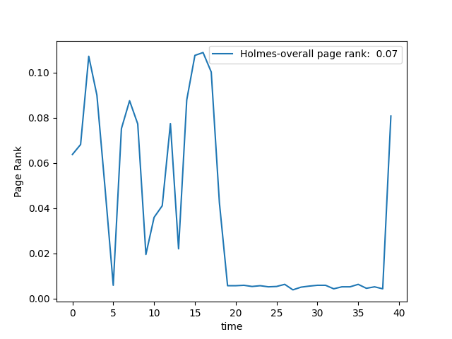
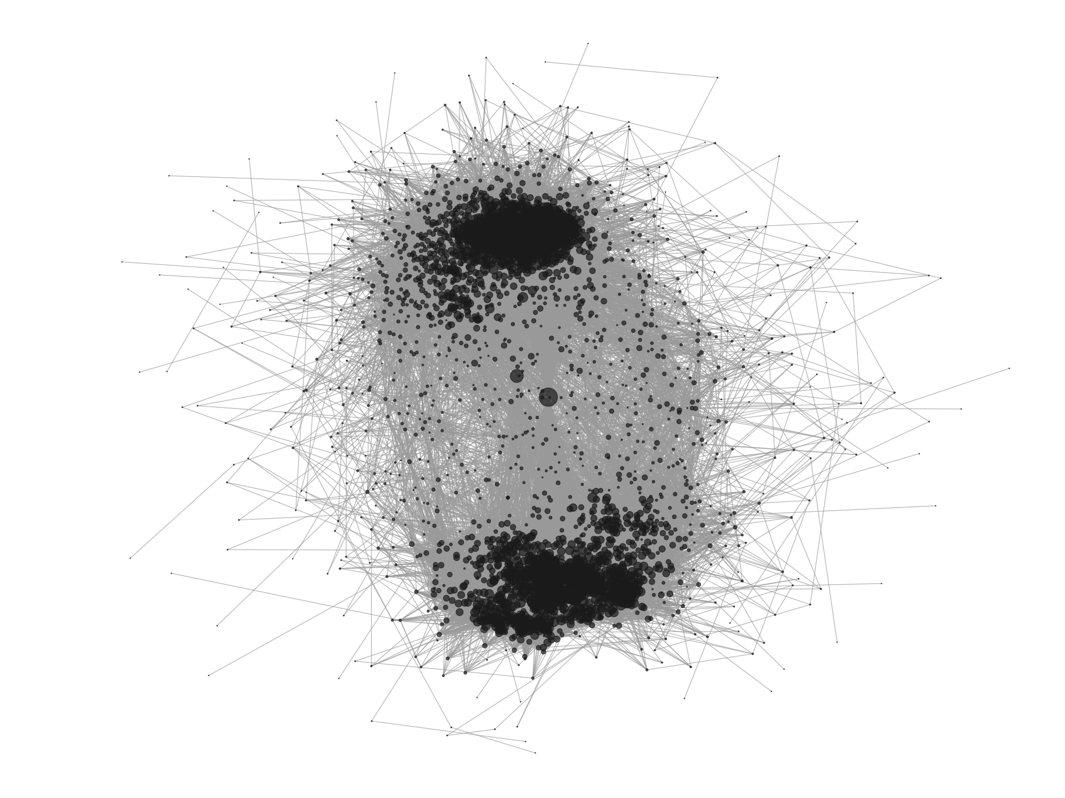
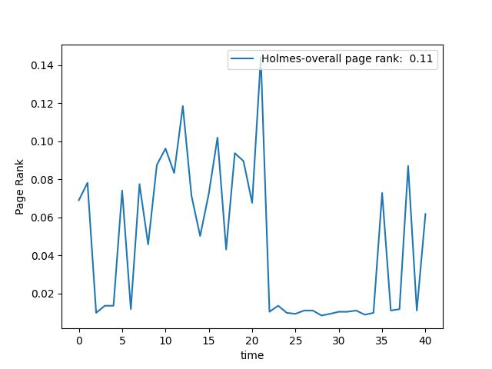
Methods: Similar Patterns
Patterns => main character importance => pagerank
15 snapshots
5 levels
> 80%
83%
Notes:
This is another method we used to compare books. We tried to find patterns in the books storyline. these two plots in the right which are main character importance or appearance in the story timeline of two sherlock holmes series, were really similar two each other. main character is absent in the middle of the book and then is present at the end. so we thought maybe we can find more patterns like this for main character importance. we tried to compare books based on a simple method which is like when a human compare two plots. we used 15 snapshots of the book, changed the pagerank of main character to 5 levels from high to low. and then compared those levels for two books. if they were similar more than 80%. an edge was created between them. for example these two books are 83% similar. in the bottom left, here is the similarity graph. nodes with similar books are black and edges are grey.

Slide 11
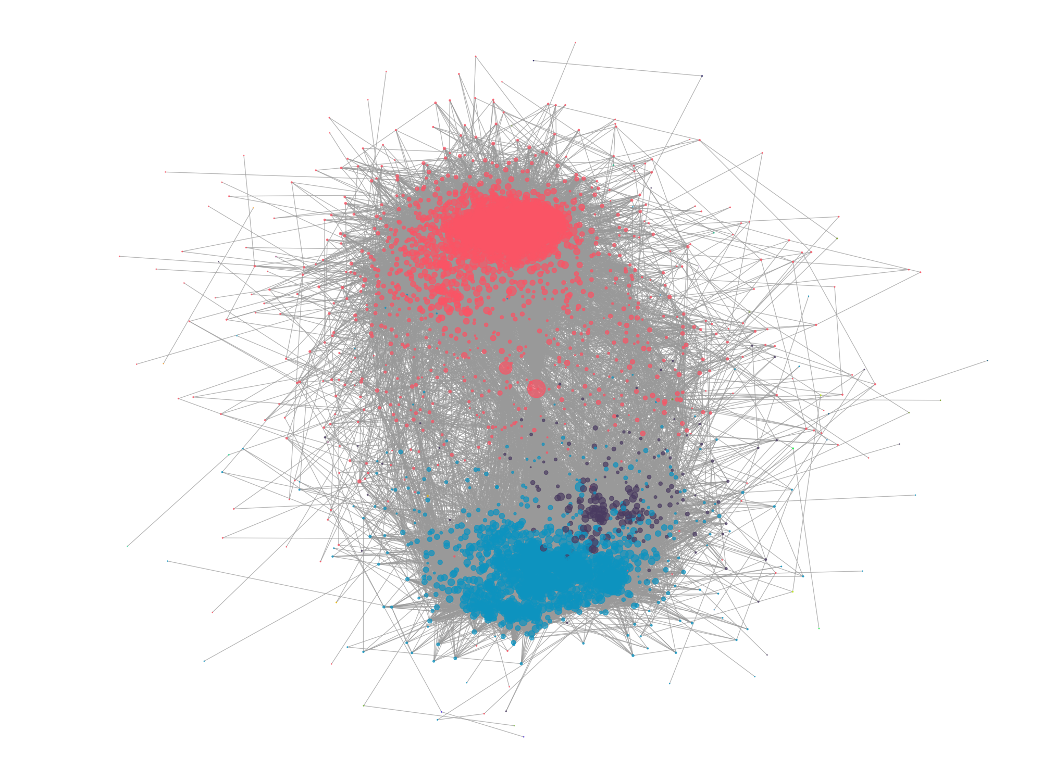
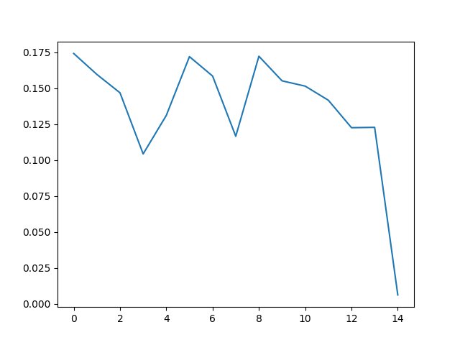
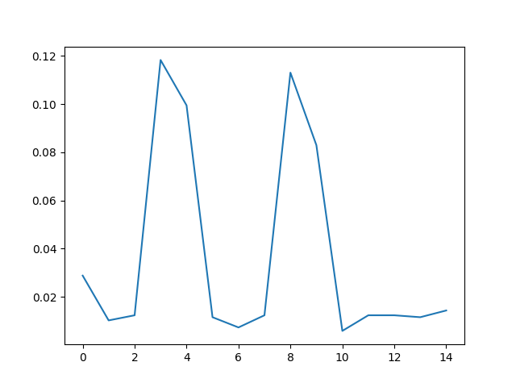
Results: Main Character Similarity Graph
59 communities in full graph
2 main communities (>1000)
Single main character & multiple main characters
Single
Multiple
Notes:
it was interesting that nodes grouped in two sides of the graph so we ran a community detection algorithm on the graph. from 59 detected communities in the full graph, 2 were larger than other communities. they had more than 1000 nodes. we further investigated the books in these two communities. one was books with single main character and the other one was with multiple main characters. it’s logical that books be separated in two groups of single and multiple main characters, when they were compared based on the main character’s importance or appearance in the book.

Slide 12
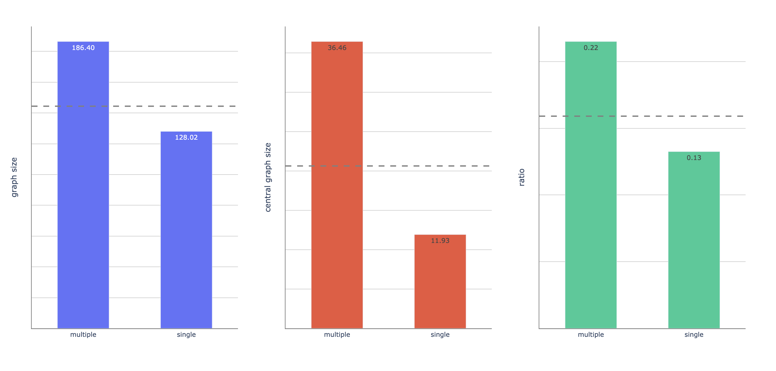
Main Character Importance Similarity Graph Communities
Community 1: “single main character” (“single”) #books: 1638
Community 2: “multiple central characters” (“multiple”) #books: 1020
dashed lines show the overall mean for all books.
Notes:
in blue and red plots you see books with multiple main characters have more characters in total and central part of them because they are about a larger group of people. and also in the green plot you see ratio of the total characters to the central characters. for books with single main character it’s lower. it means those books are mostly about a central group of people.

Slide 13
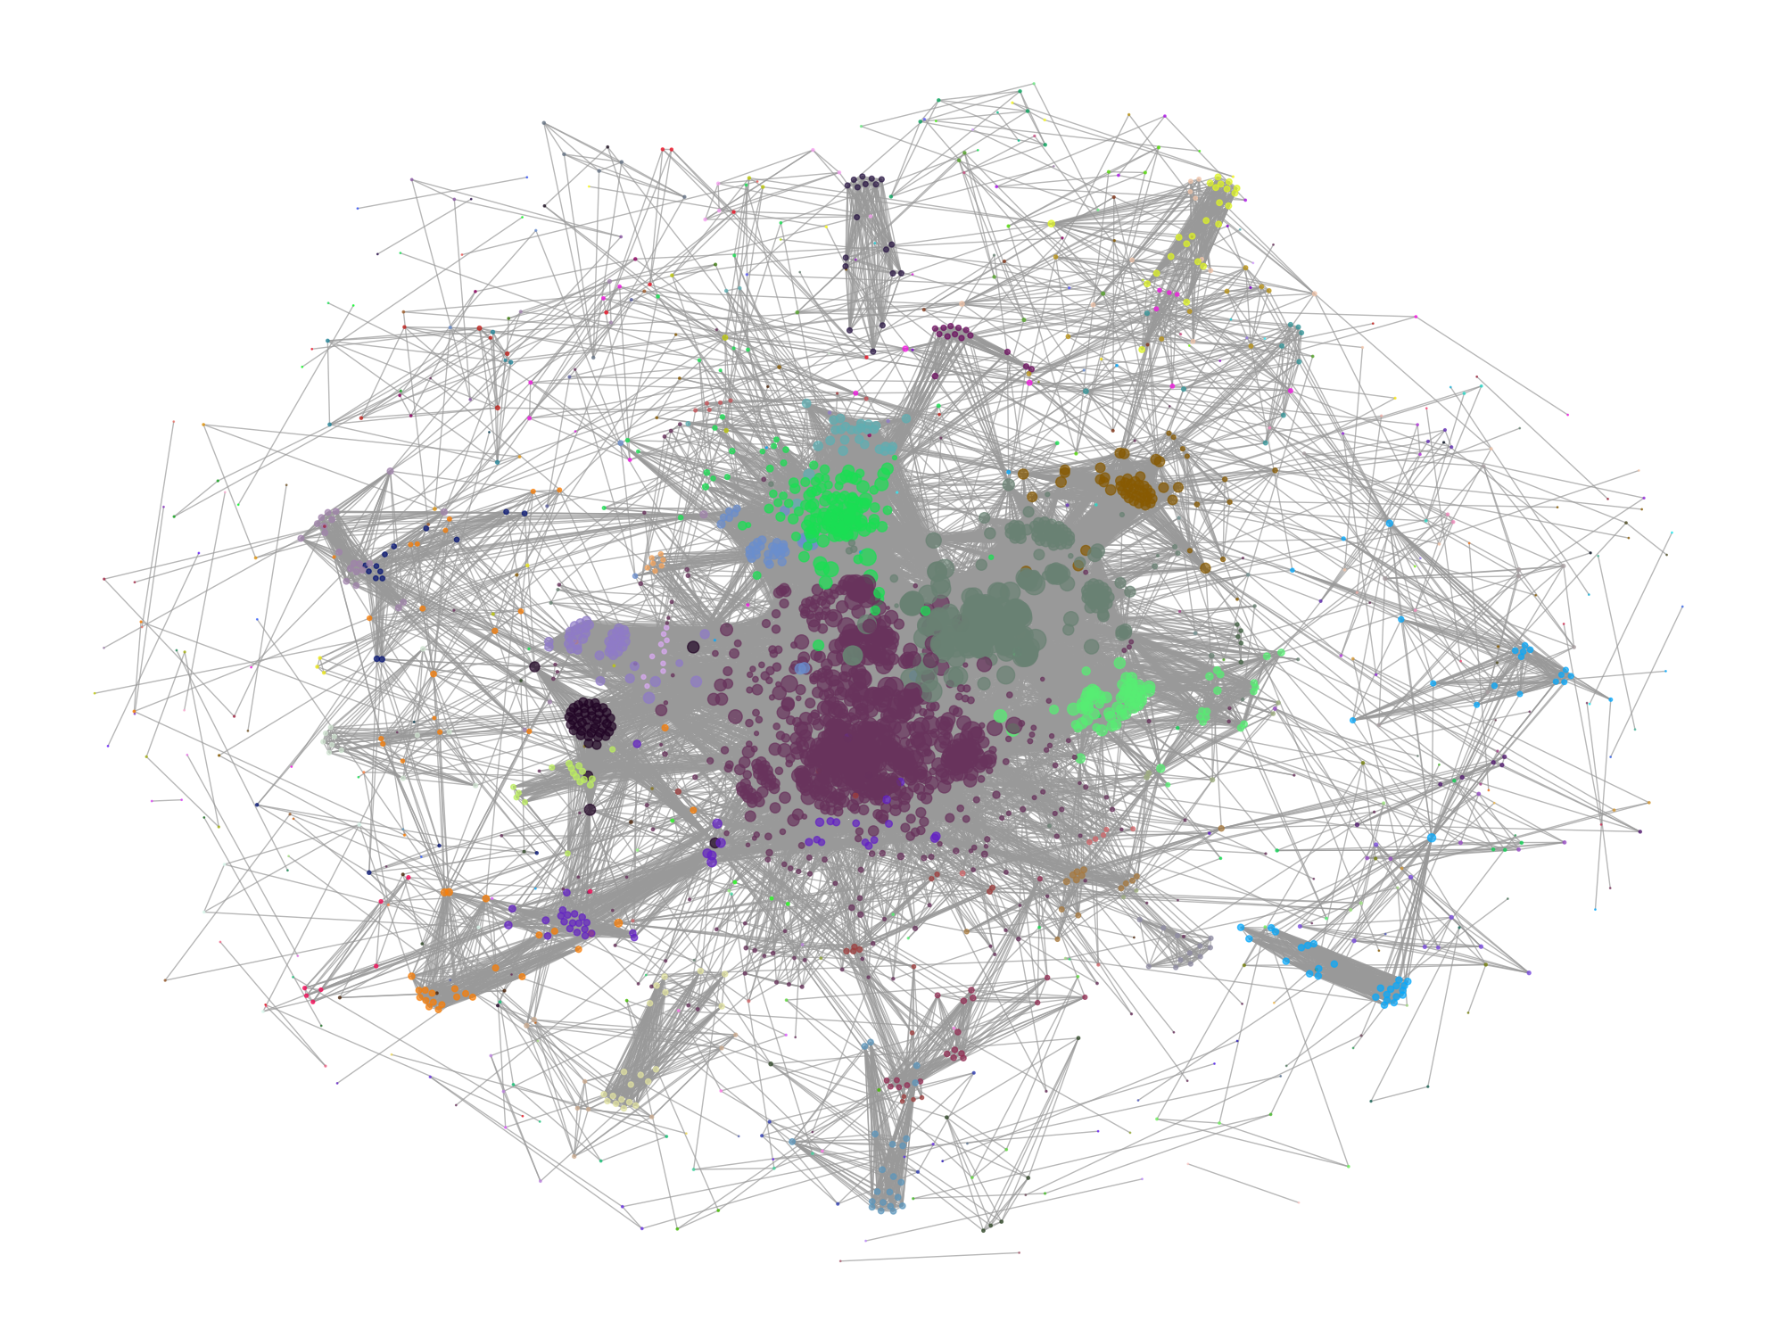
Methods: Category
['Courtship -- Fiction', 'England -- Fiction', 'Inheritance and succession -- Fiction', 'Love stories']
32 ['Prairies -- Fiction', 'Western stories']
32 ['Gold mines and mining -- Alaska', 'Klondike River Valley -- Gold discoveries -- Fiction', 'Western stories']
32 ['Arizona -- Fiction', 'Bildungsromans', 'Western stories']
32 ['Dakota Territory -- Fiction', 'Ranch life -- Fiction', 'Western stories']
Notes:
another method we used, is how to find the main category. Here in top there is an example of a book’s category. there are different subjects. we can’t assign one as main category because there are about 3000 subjects in our dataset which is kind of equal to number of the books. so what we did, we made a graph of categories, and if two books had a common subject, we introduced an edge between them. since related books grouped together as you see in the picture, we executed a community detection algorithm. and we had what we wanted. each community kind of represented a category. we had about 500 communities on the main graph and 68 communities on the largest connected component, which we mostly used the largest connected component. below you see an example of a community which is mainly about Western Stories.

Slide 14
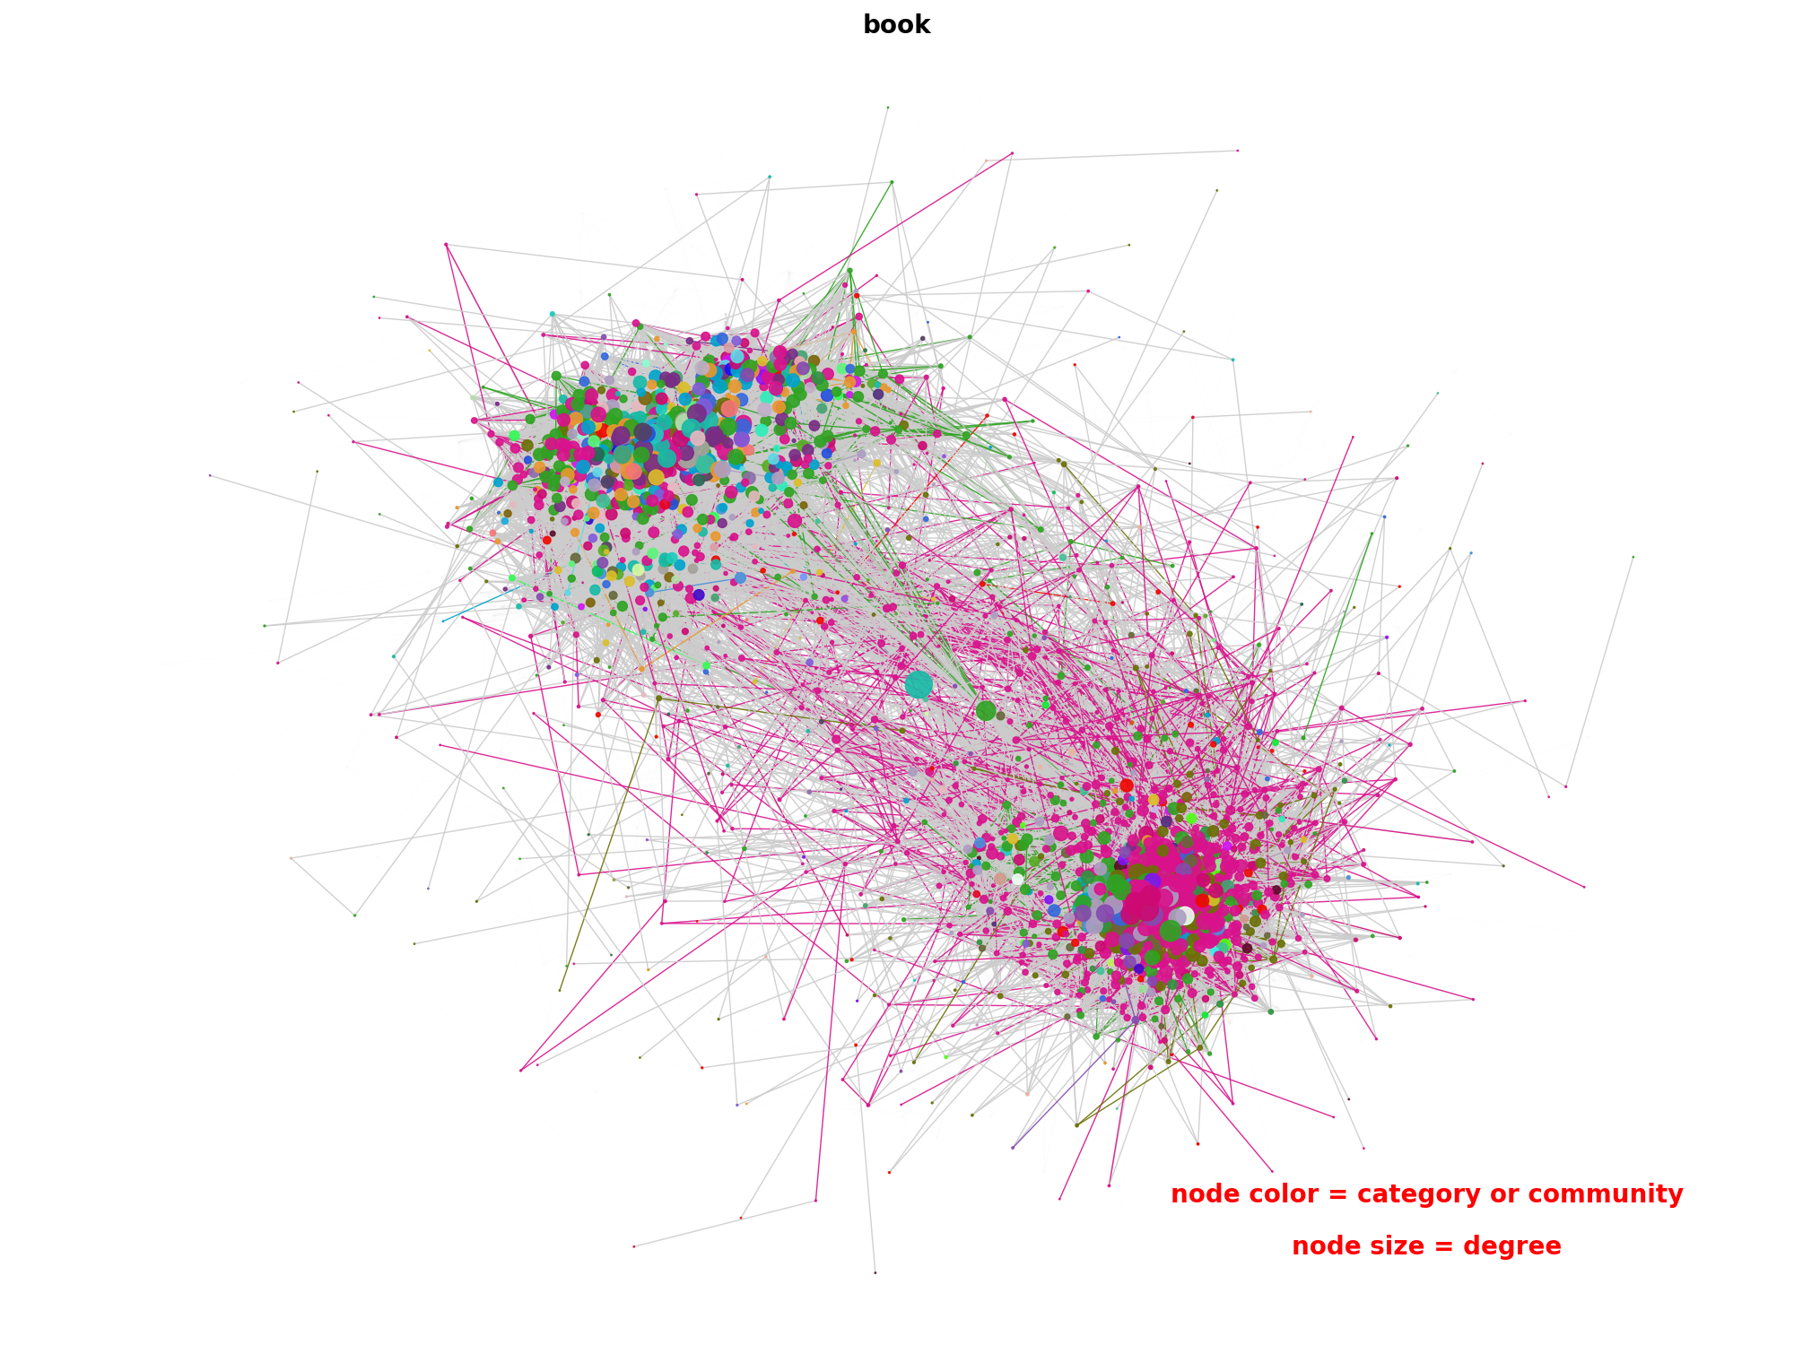
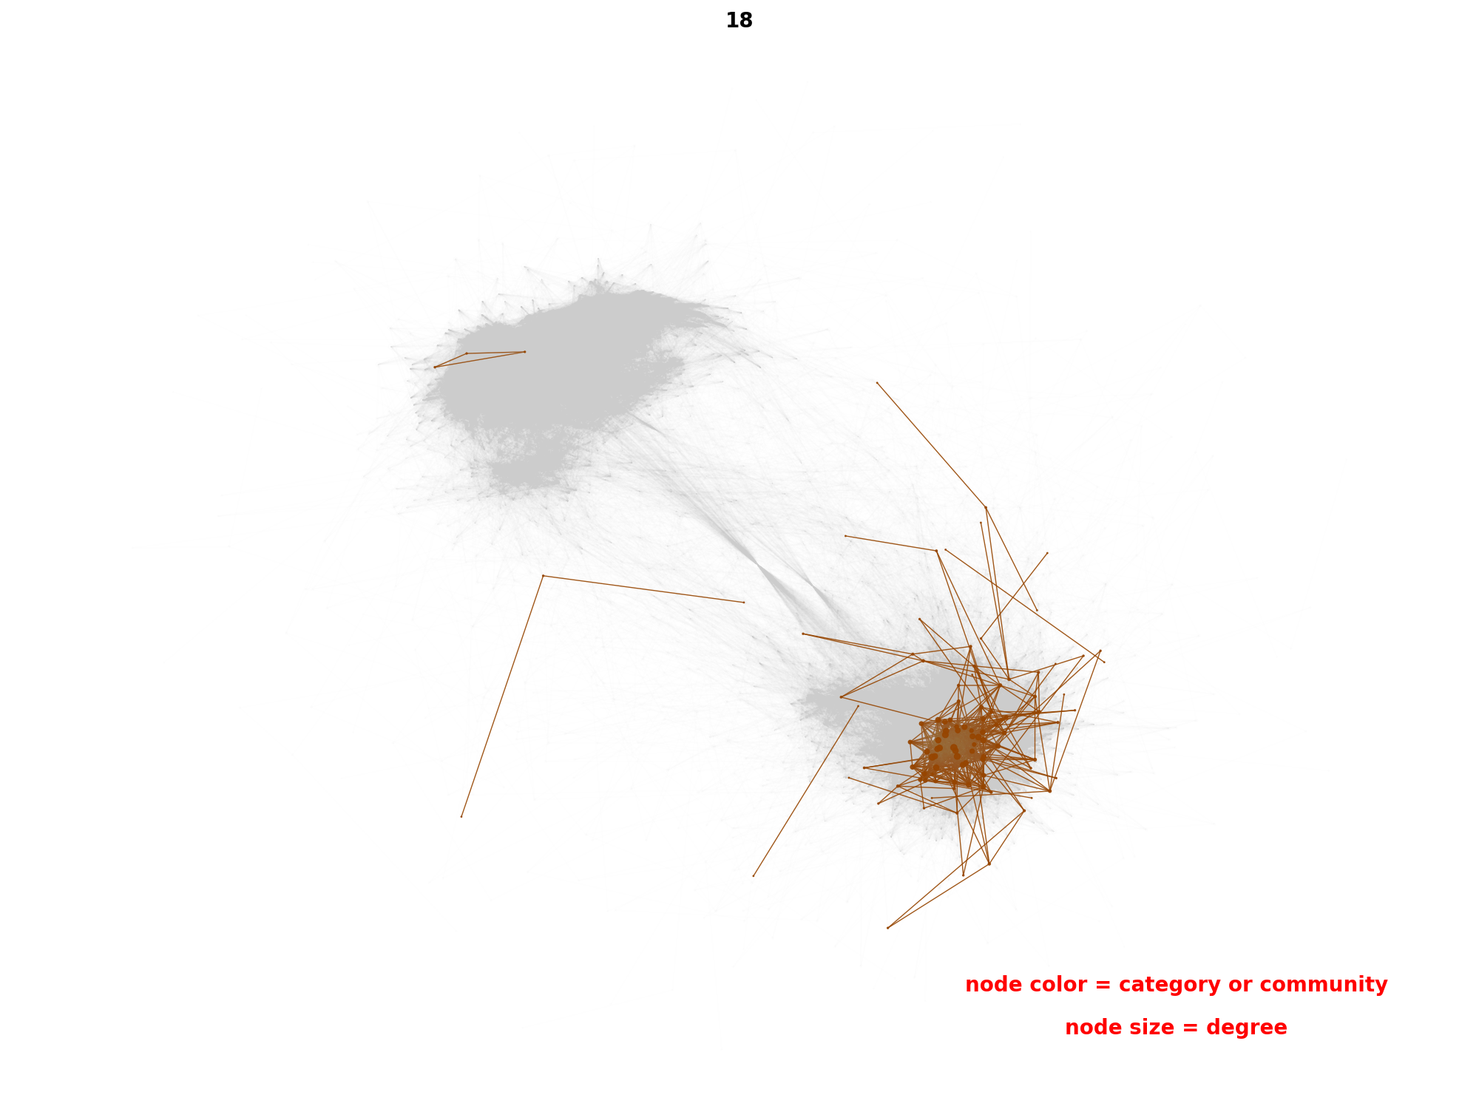
Results: Category and Main Character Similarity Graph
⅔ of Books
Single main character
Similar patterns
All categories on LCC
Juvenile fiction
Notes:
Then we colored categories on the largest connected component of the similarity graph. we noticed that same colors were mostly in one side of the graph. therefore we colored each category individually on the LCC. results were interesting. ⅔ of the books were located not also in one side of graph which shows multiple or single main character but also they were connected to each other which shows they were using similar patterns. here is an example, juvenile fiction books are mostly about a single main character. and also they have repeated patterns in themselves since they are connected to each other on the graph.

Slide 15
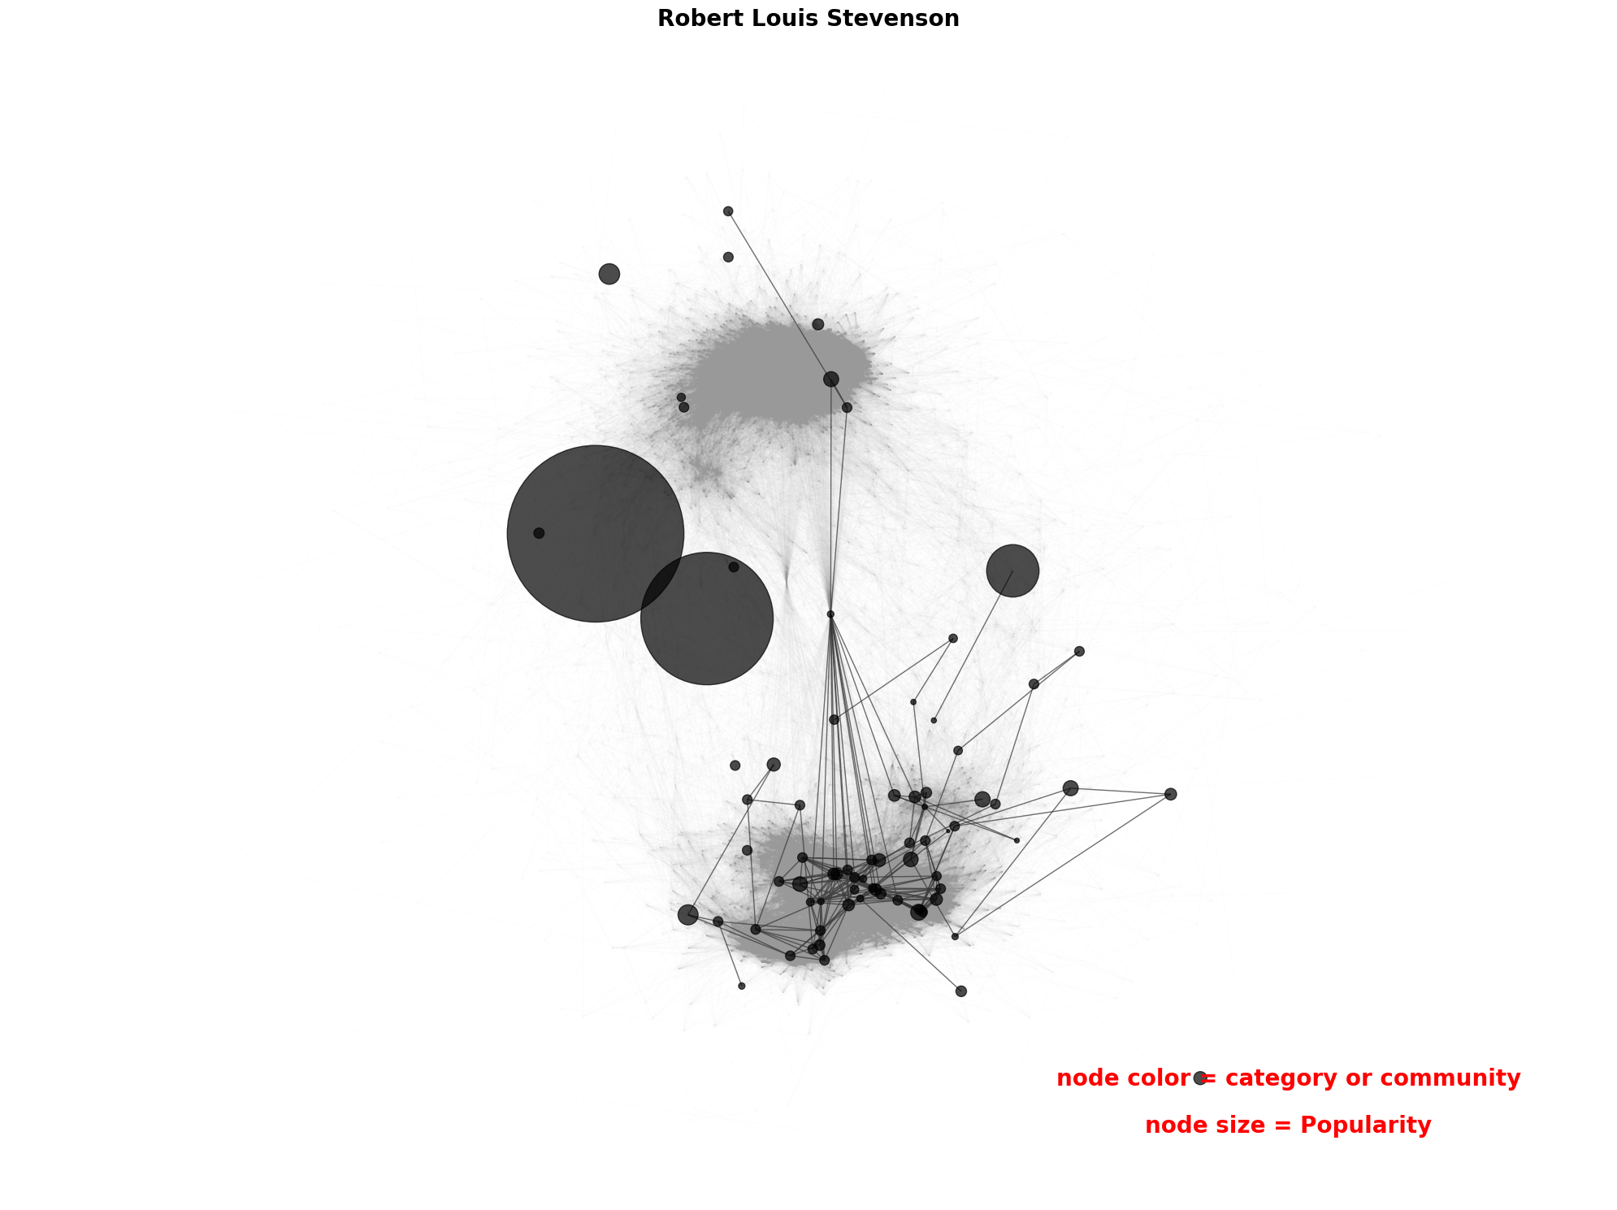
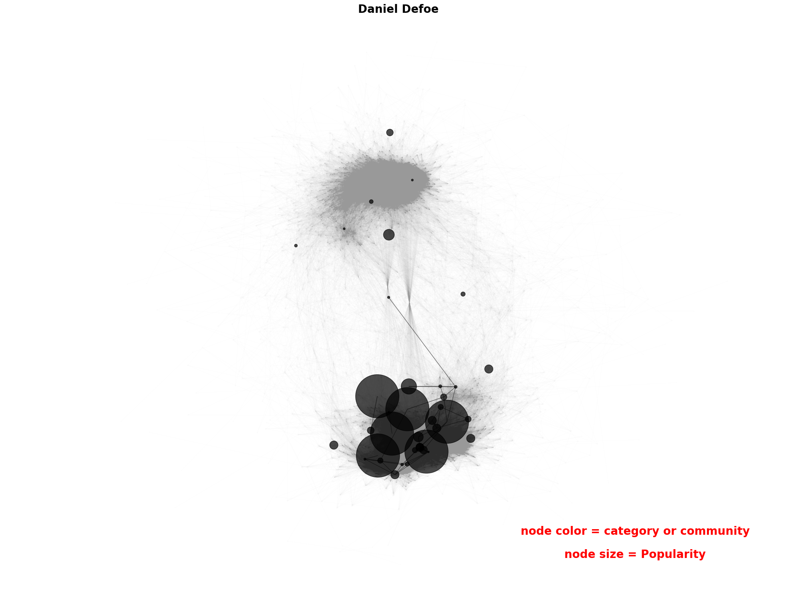
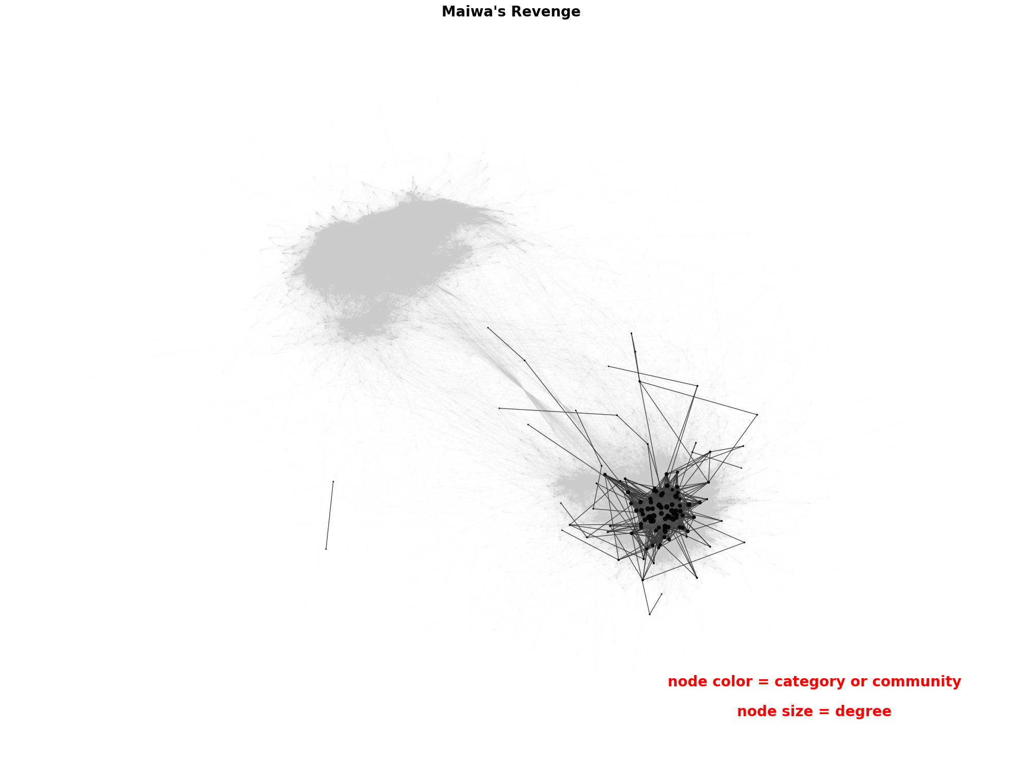
Results: Author, Popularity, and Main Character Similarity Graph
½ of Authors
Single main character
Similar patterns
H. Rider Haggard
Daniel Defoe
Robert Louis Stevenson
Notes:
again like category we colored books of authors. about half of the authors used repeated patterns in their books. then we tried to answer this question that does deviating from those patterns makes a book popular or unpopular? we changed the node sizes to the popularity of a book. for some authors like daniel defoe, central books in the similarity graph were popular, and for some authors like robert louis stevenson, deviation from other books made them popular.

Slide 16
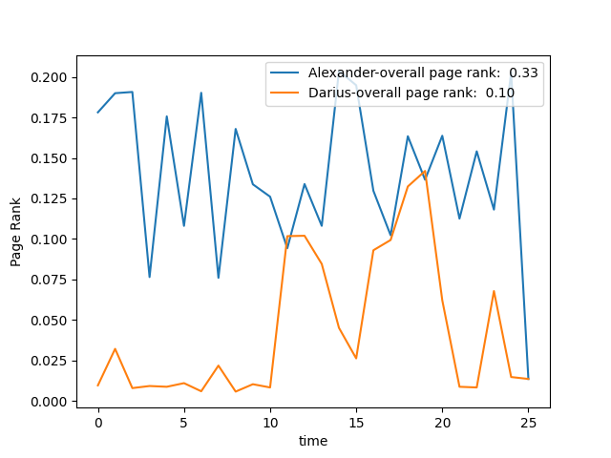
Interesting Variations and Further Improvements
Interesting variations
Analyse other character’s importance through time
Edge importance and Edge importance through time
Adding sentiment to edges based on the overall sentiment of the sections
Potential Application
History books (Biography of Alexander the Great by Jacob Abbott)
Alexander the Great defeated Darius III of Persia
Notes:
We analysed the main character importance through time. But our graphs also allow to analyse other character’s importance, also we can analyse edge importance and edge importance through time using our interaction networks.
One more advanced analysis that requires creating new graphs is to include sentiment to the interactions based on the overall sentiment of the sections that names appear together. We believe this will be very interesting.
I also wanted to point out that when we were analysing the characters in different books, we realised in the Biography of Alexander the Great written by Jacob Abbott, the second important character is Darius (Persia’s king of the time). Then we plotted their importance through time. We can see that Darius appears here and then disappears. We searched the names and found out that Alexander defeated Darius the III in a battle, so this might be related to that. Based on this we believe our method might also be useful to visualize history books and historical events.

Slide 17
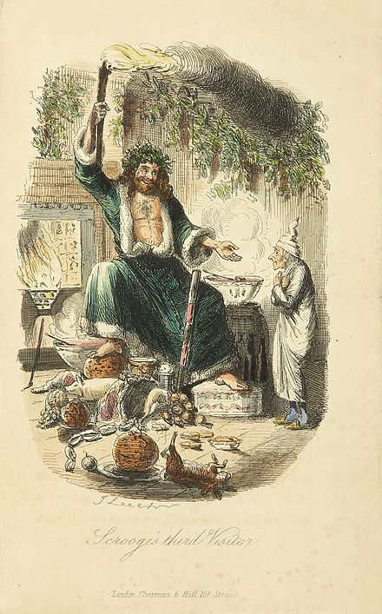
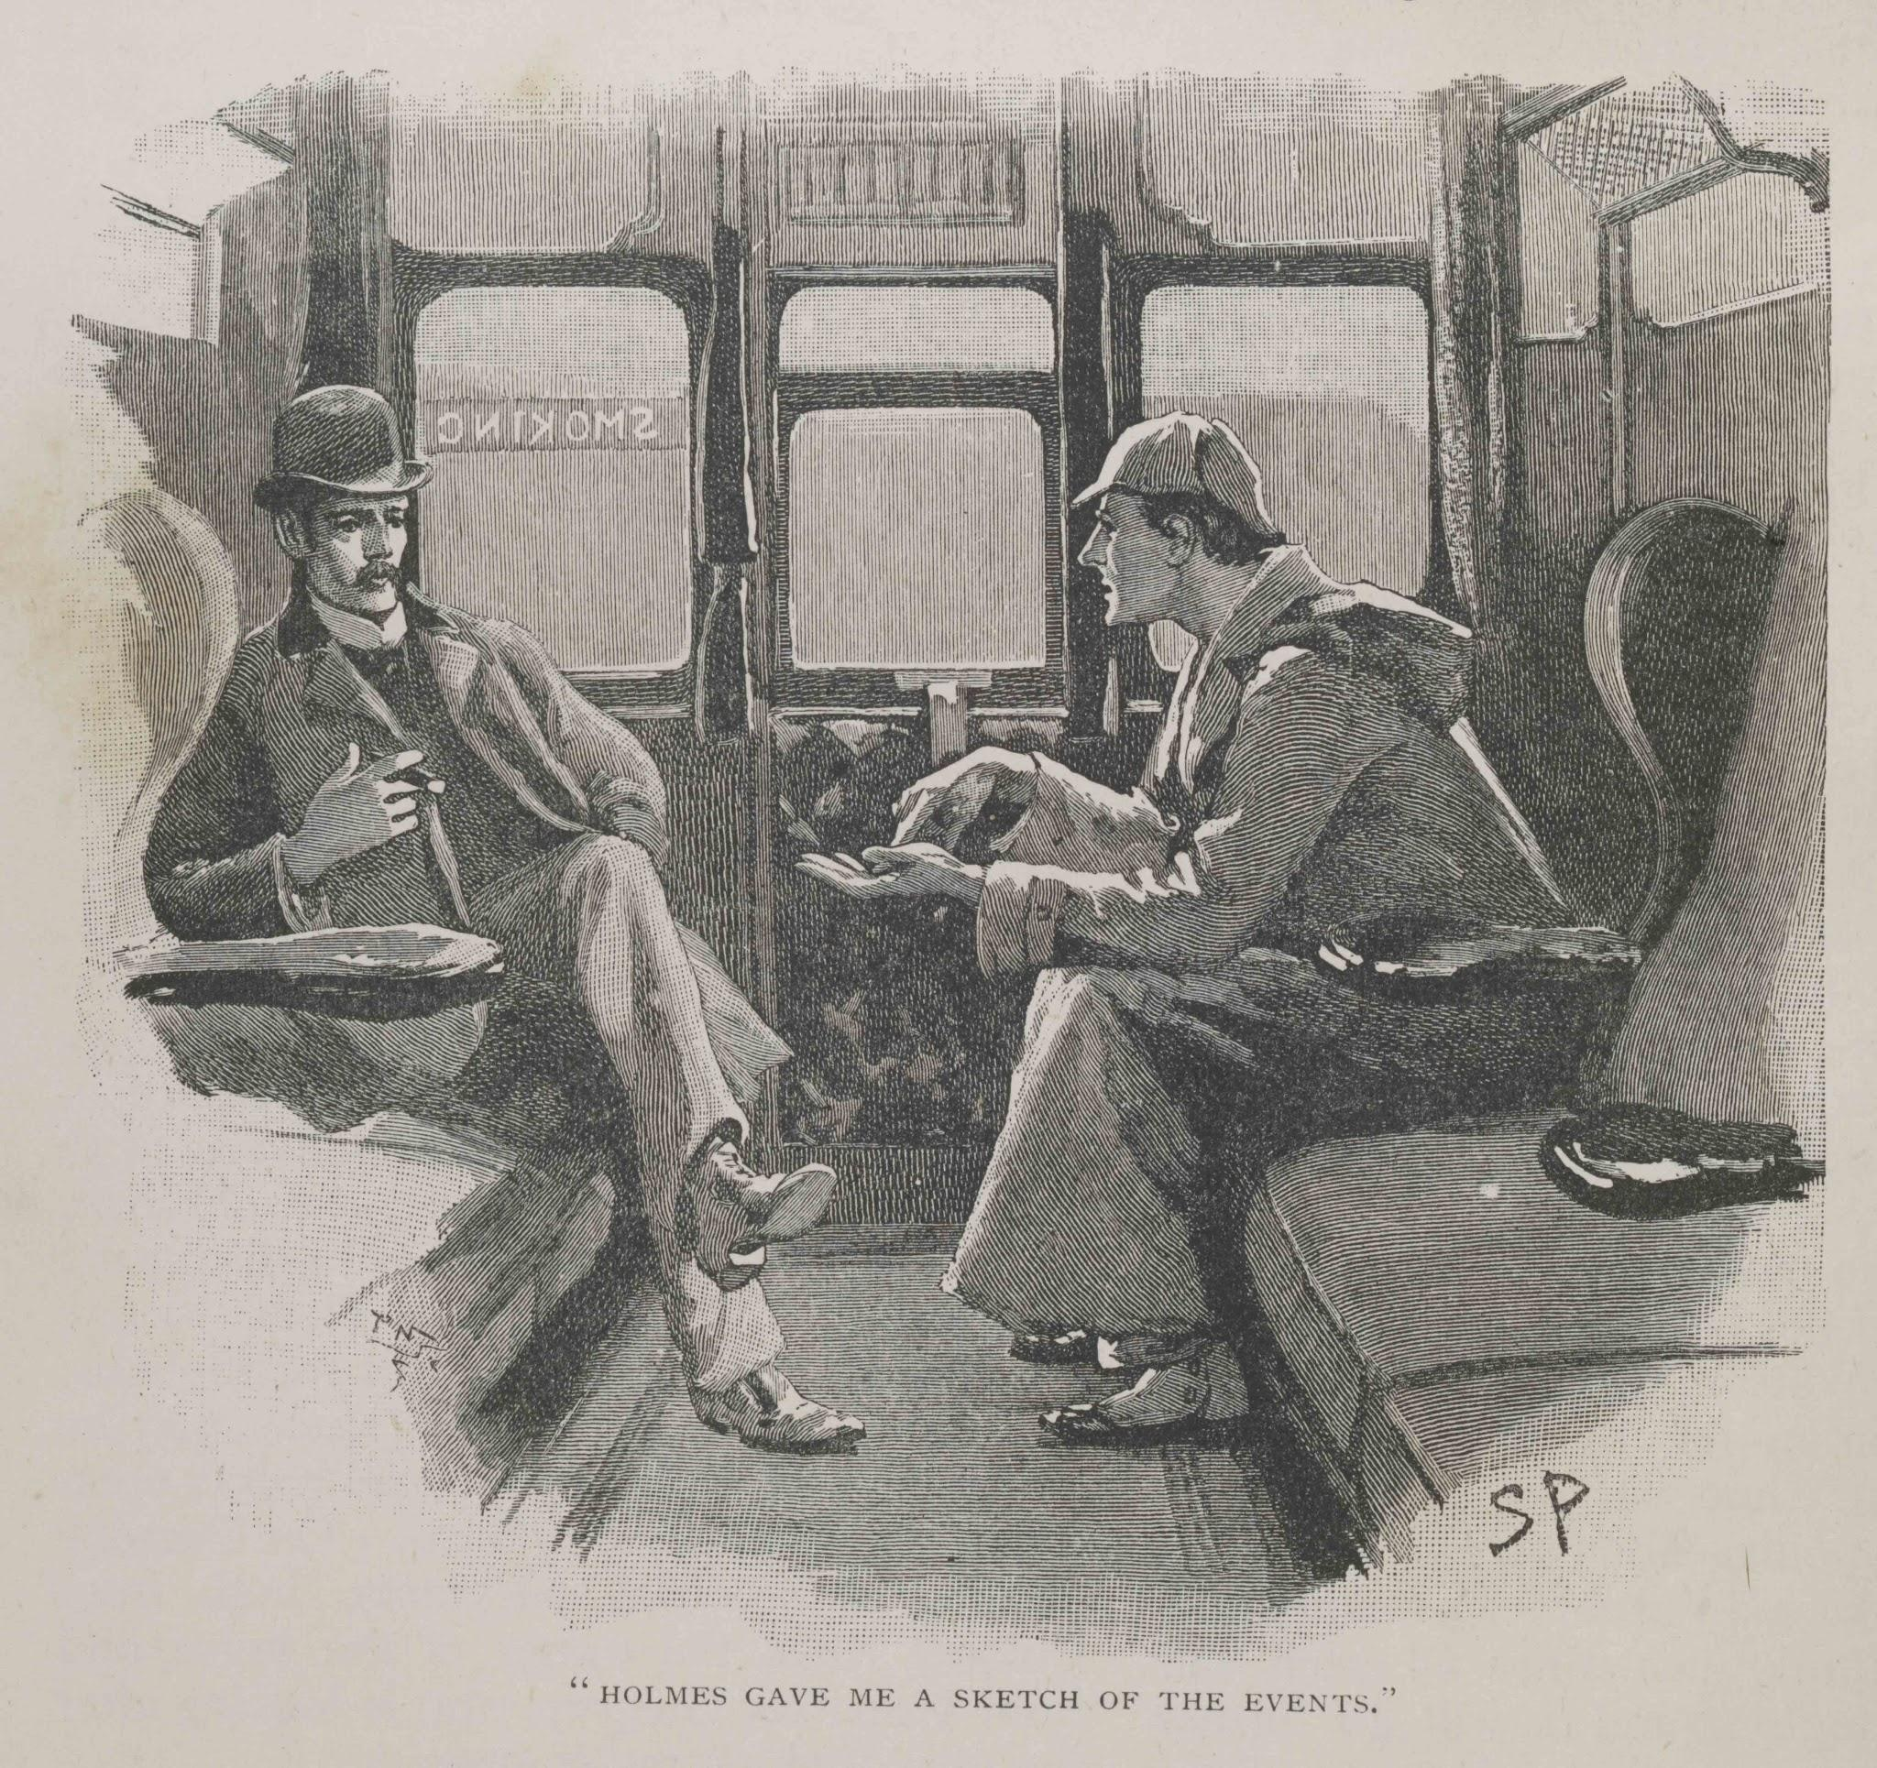
Limitations
Graph Creation:
Ignoring “I” in first person narrator (e.g. Dr. Watson in Sherlock Holmes series)
Strange names (e.g. The Ghosts of the Christmas in A Christmas Carol)
Same character (e.g. Mr. Potter = Harry Potter or James Potter)
Watson and Holmes in a Sidney Paget illustration for "The Adventure of Silver Blaze".
Wikipedia
Scrooge encounters the Ghost of Christmas Present - illustration by John Leech (1843) Wikipedia
Notes:
We have identified three major unresolved challenges that make our character interaction networks inaccurate. first we ignore pronouns in our method and for first person narrator books, this causes some error, for example Dr watson in sherlock holmes is more important than what our method finds. Second, our method does not extract strange character names, for example the ghosts of christmas in a christmas charole are completely ignored, but they are pretty important. And third, sometimes it is not possible to determine what names refer to the same characters, and this also causes some error in our name extraction method.
Also we created the main character similarity graph baked on our simple time series comparison method, we believe more advanced methods can also be used and they might reveal more complex similarity communities.

Slide 18
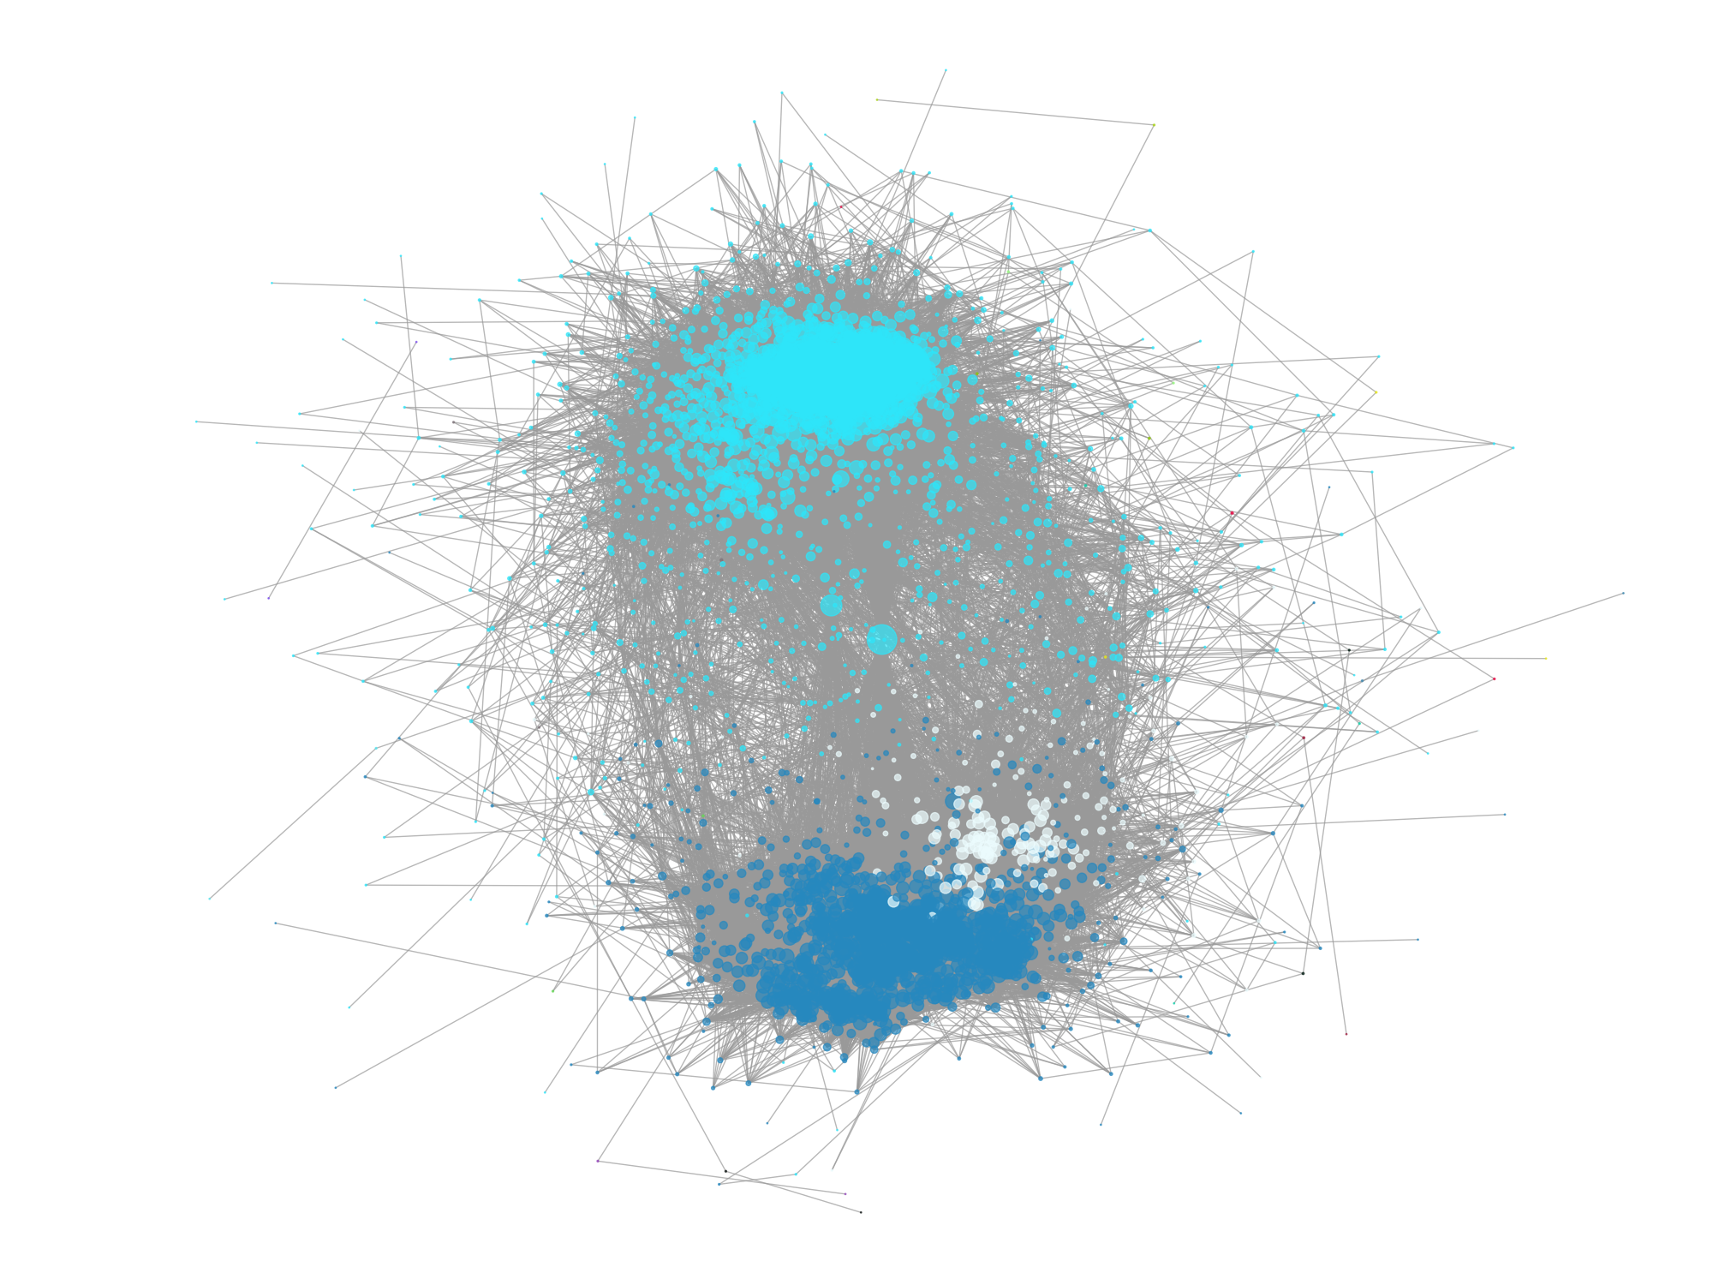
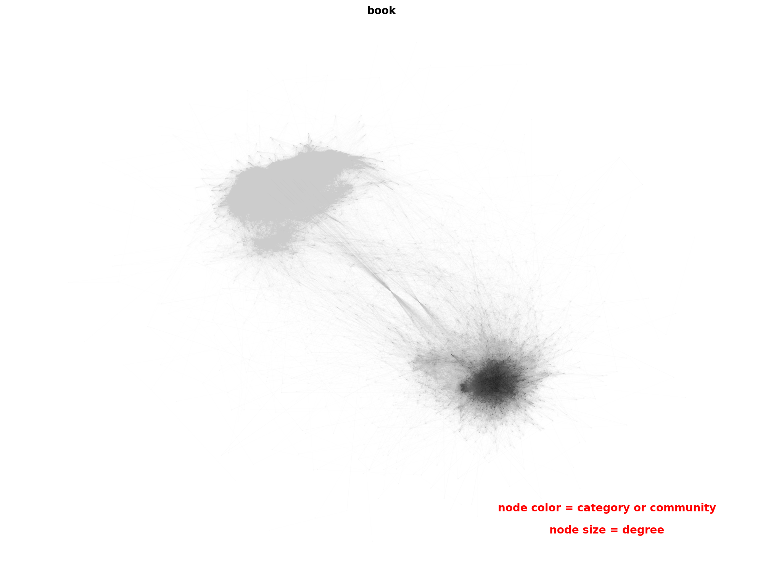
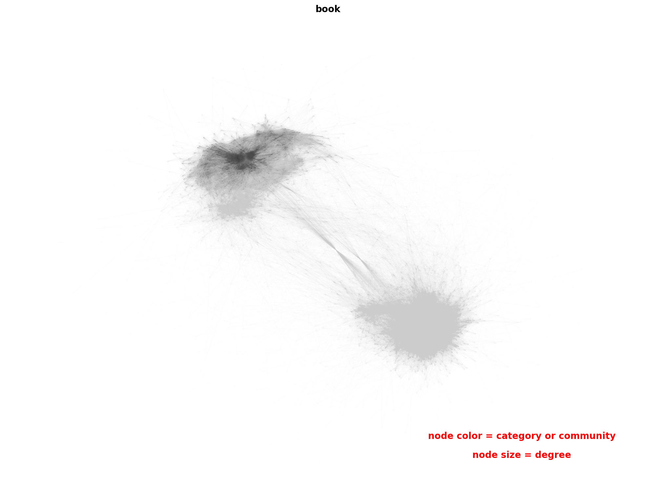
Conclusion
Notes:
doing Natural language processing on a large dataset of books showed that there are 2 main communities based on the main character: single main character and multiple main characters. Similar patterns were shared among books of same category or same author. Sometimes deviating from the similarity network made a book popular and sometime being as a central book made it popular. Also we saw that books with different subjects have different number of nodes, and we kinda showed some author’s styles about how many characters they use. we only did most of these analyses for one character. but what if we do it for two main characters or for sentiments. we believe that our method is extendable to them and it could reveal new insights into the books without reading them. Thank you for listening. if you have any questions you can ask us now!

